Slide 1
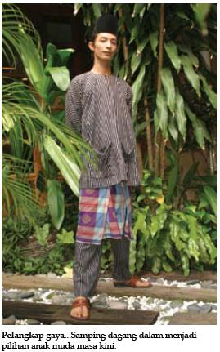
Notes:
This is another option for an Overview slides using transitions.

